Slide 1

Notes:
Source: GCSE Media Studies for AQA, uploaded as Year 11 Media Design.pdf, printed pages 25–29, How films are promoted: film posters. Classroom adaptation. Lesson 2 applies these concepts in a teacher-designed practical task. Original poster examples on Lesson 1 slides 9 and 14 from printed pages 25 and 28. Other illustrations generated as conceptual teaching visuals.

Slide 2

Notes:
Source: GCSE Media Studies for AQA, uploaded as Year 11 Media Design.pdf, printed pages 25–29, How films are promoted: film posters. Classroom adaptation. Lesson 2 applies these concepts in a teacher-designed practical task. Original poster examples on Lesson 1 slides 9 and 14 from printed pages 25 and 28. Other illustrations generated as conceptual teaching visuals.

Slide 3
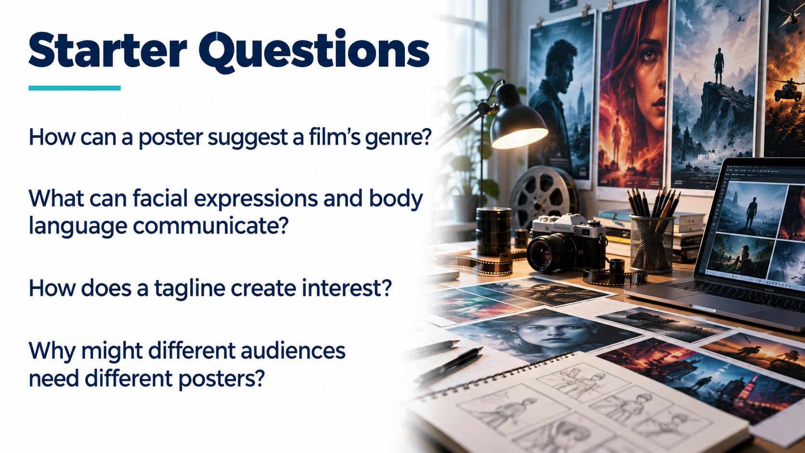
Notes:
Source: GCSE Media Studies for AQA, uploaded as Year 11 Media Design.pdf, printed pages 25–29, How films are promoted: film posters. Classroom adaptation. Lesson 2 applies these concepts in a teacher-designed practical task. Original poster examples on Lesson 1 slides 9 and 14 from printed pages 25 and 28. Other illustrations generated as conceptual teaching visuals.

Slide 4

Notes:
Source: GCSE Media Studies for AQA, uploaded as Year 11 Media Design.pdf, printed pages 25–29, How films are promoted: film posters. Classroom adaptation. Lesson 2 applies these concepts in a teacher-designed practical task. Original poster examples on Lesson 1 slides 9 and 14 from printed pages 25 and 28. Other illustrations generated as conceptual teaching visuals.

Slide 5

Notes:
Source: GCSE Media Studies for AQA, uploaded as Year 11 Media Design.pdf, printed pages 25–29, How films are promoted: film posters. Classroom adaptation. Lesson 2 applies these concepts in a teacher-designed practical task. Original poster examples on Lesson 1 slides 9 and 14 from printed pages 25 and 28. Other illustrations generated as conceptual teaching visuals.

Slide 6

Notes:
Source: GCSE Media Studies for AQA, uploaded as Year 11 Media Design.pdf, printed pages 25–29, How films are promoted: film posters. Classroom adaptation. Lesson 2 applies these concepts in a teacher-designed practical task. Original poster examples on Lesson 1 slides 9 and 14 from printed pages 25 and 28. Other illustrations generated as conceptual teaching visuals.

Slide 7
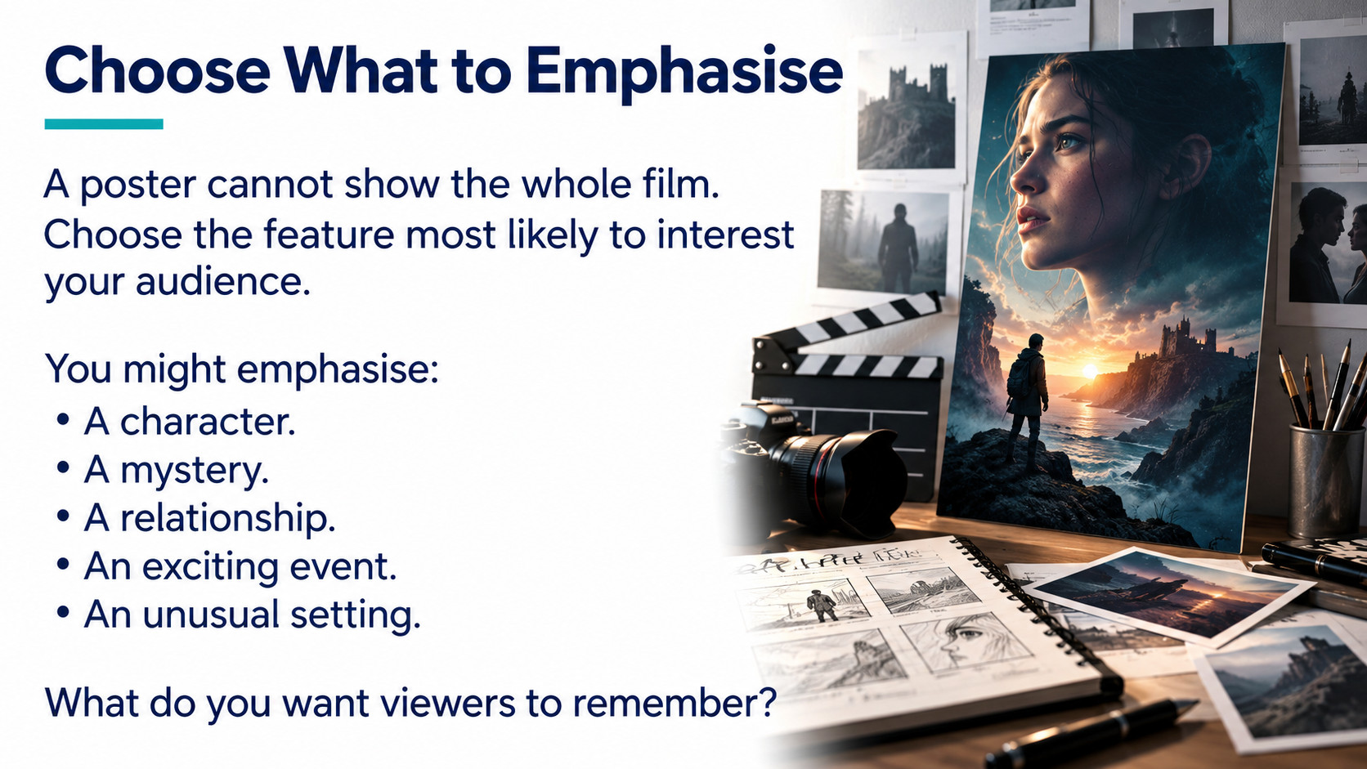
Notes:
Source: GCSE Media Studies for AQA, uploaded as Year 11 Media Design.pdf, printed pages 25–29, How films are promoted: film posters. Classroom adaptation. Lesson 2 applies these concepts in a teacher-designed practical task. Original poster examples on Lesson 1 slides 9 and 14 from printed pages 25 and 28. Other illustrations generated as conceptual teaching visuals.

Slide 8

Notes:
Source: GCSE Media Studies for AQA, uploaded as Year 11 Media Design.pdf, printed pages 25–29, How films are promoted: film posters. Classroom adaptation. Lesson 2 applies these concepts in a teacher-designed practical task. Original poster examples on Lesson 1 slides 9 and 14 from printed pages 25 and 28. Other illustrations generated as conceptual teaching visuals.

Slide 9

Notes:
Source: GCSE Media Studies for AQA, uploaded as Year 11 Media Design.pdf, printed pages 25–29, How films are promoted: film posters. Classroom adaptation. Lesson 2 applies these concepts in a teacher-designed practical task. Original poster examples on Lesson 1 slides 9 and 14 from printed pages 25 and 28. Other illustrations generated as conceptual teaching visuals.

Slide 10

Notes:
Source: GCSE Media Studies for AQA, uploaded as Year 11 Media Design.pdf, printed pages 25–29, How films are promoted: film posters. Classroom adaptation. Lesson 2 applies these concepts in a teacher-designed practical task. Original poster examples on Lesson 1 slides 9 and 14 from printed pages 25 and 28. Other illustrations generated as conceptual teaching visuals.

Slide 11

Notes:
Source: GCSE Media Studies for AQA, uploaded as Year 11 Media Design.pdf, printed pages 25–29, How films are promoted: film posters. Classroom adaptation. Lesson 2 applies these concepts in a teacher-designed practical task. Original poster examples on Lesson 1 slides 9 and 14 from printed pages 25 and 28. Other illustrations generated as conceptual teaching visuals.

Slide 12

Notes:
Source: GCSE Media Studies for AQA, uploaded as Year 11 Media Design.pdf, printed pages 25–29, How films are promoted: film posters. Classroom adaptation. Lesson 2 applies these concepts in a teacher-designed practical task. Original poster examples on Lesson 1 slides 9 and 14 from printed pages 25 and 28. Other illustrations generated as conceptual teaching visuals.

Slide 13

Notes:
Source: GCSE Media Studies for AQA, uploaded as Year 11 Media Design.pdf, printed pages 25–29, How films are promoted: film posters. Classroom adaptation. Lesson 2 applies these concepts in a teacher-designed practical task. Original poster examples on Lesson 1 slides 9 and 14 from printed pages 25 and 28. Other illustrations generated as conceptual teaching visuals.

Slide 14
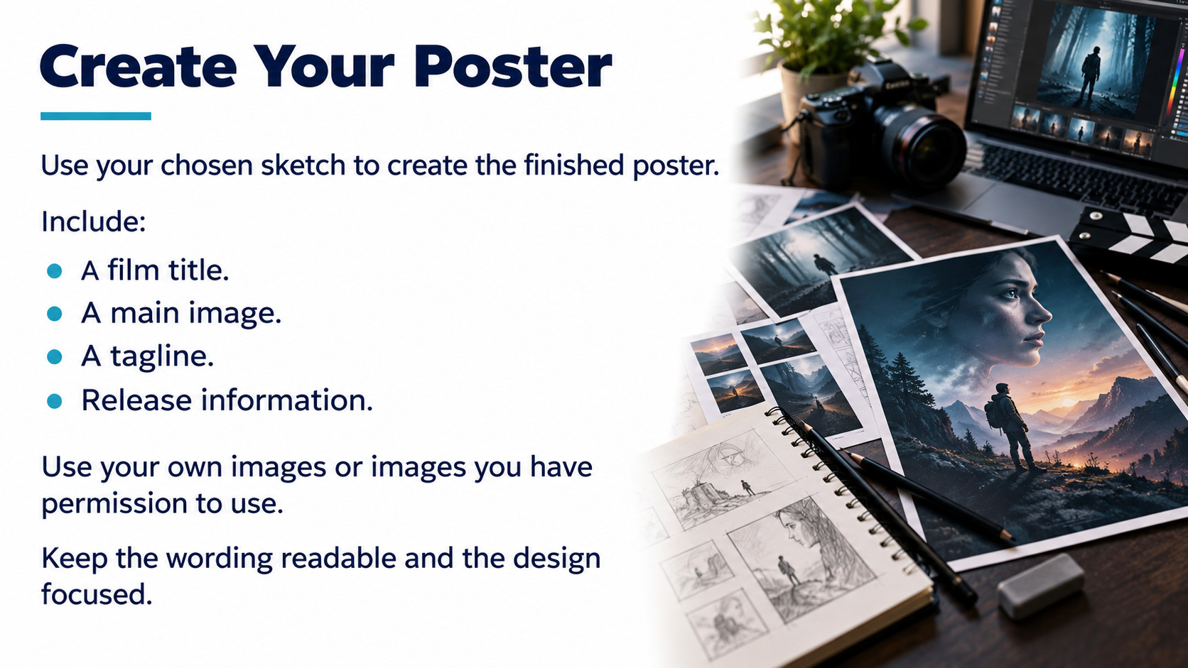
Notes:
Source: GCSE Media Studies for AQA, uploaded as Year 11 Media Design.pdf, printed pages 25–29, How films are promoted: film posters. Classroom adaptation. Lesson 2 applies these concepts in a teacher-designed practical task. Original poster examples on Lesson 1 slides 9 and 14 from printed pages 25 and 28. Other illustrations generated as conceptual teaching visuals.

Slide 15
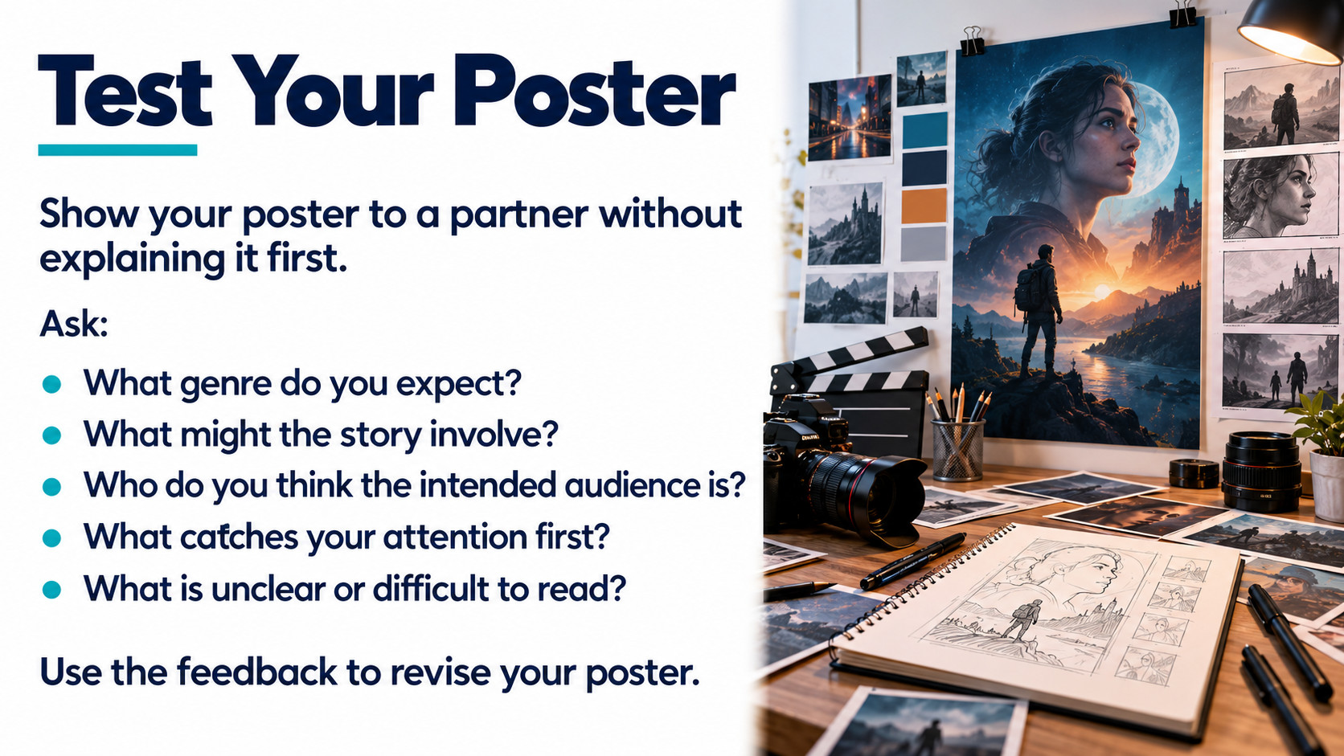
Notes:
Source: GCSE Media Studies for AQA, uploaded as Year 11 Media Design.pdf, printed pages 25–29, How films are promoted: film posters. Classroom adaptation. Lesson 2 applies these concepts in a teacher-designed practical task. Original poster examples on Lesson 1 slides 9 and 14 from printed pages 25 and 28. Other illustrations generated as conceptual teaching visuals.

Slide 16
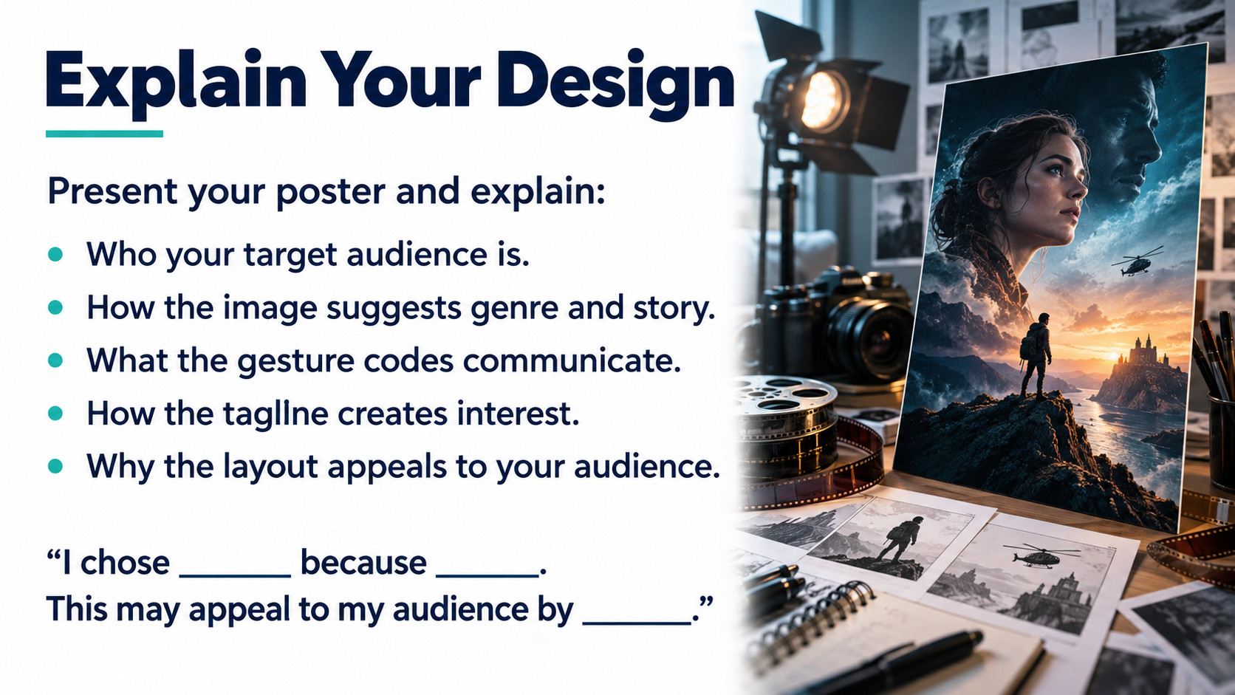
Notes:
Source: GCSE Media Studies for AQA, uploaded as Year 11 Media Design.pdf, printed pages 25–29, How films are promoted: film posters. Classroom adaptation. Lesson 2 applies these concepts in a teacher-designed practical task. Original poster examples on Lesson 1 slides 9 and 14 from printed pages 25 and 28. Other illustrations generated as conceptual teaching visuals.

Slide 17
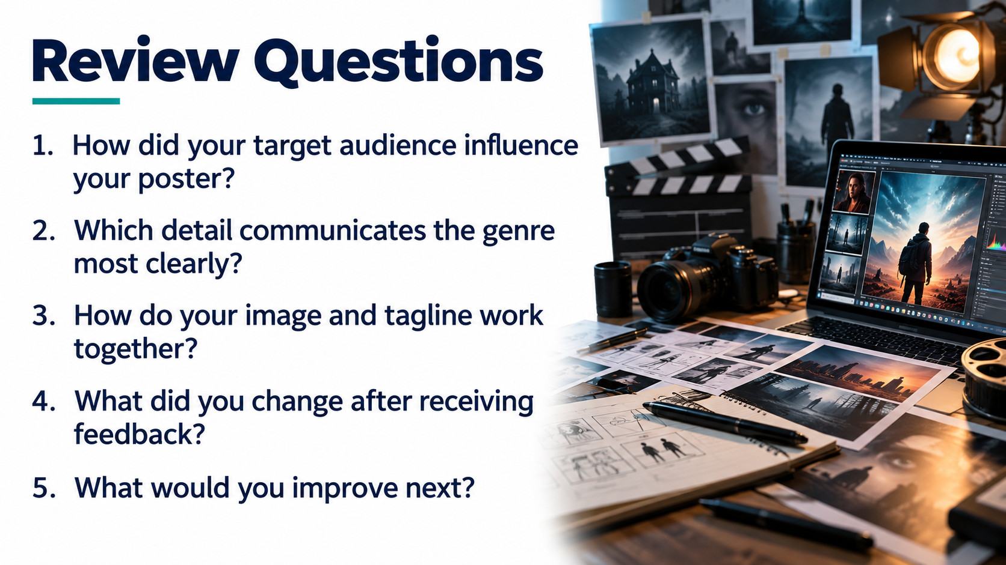
Notes:
Source: GCSE Media Studies for AQA, uploaded as Year 11 Media Design.pdf, printed pages 25–29, How films are promoted: film posters. Classroom adaptation. Lesson 2 applies these concepts in a teacher-designed practical task. Original poster examples on Lesson 1 slides 9 and 14 from printed pages 25 and 28. Other illustrations generated as conceptual teaching visuals.

